Slide 1

Account Tracker
Presented By:
Adarsh Kedia
Ashish
Nikhil Anand 15157 BITM.Santiniketan

Slide 2
Overview of Project
It is a personal finance app that help you keep track of your spending and monitors balance across multiple accounts.
This apps let you create an account in the app in which you can add and manage more than one bank account details.
You can access and update your bank data anywhere, anytime from your mobile phone.
It is easy and light and has very low system requirements.
This is a personal app i.e. you don’t need to share thus it adds to your data security.

Slide 3
Targeted User
We aim at providing this app to a wide range of users, they are
Firstly those employee working in any firms and having different bank accounts for their company and personal use.
This app can also help small scale businessmen in managing their transaction from a number of accounts.
It can also be used by students who don’t wish to go every time at banks to update their passbooks.
It can also be used at homes to get a track of home expenditure.

Slide 4
Facilities Provided
List of all bank accounts
Adding a new bank account
Updating an existing bank account
Deleting a bank account
List of transactions related to a bank account
List of recent 10 transaction from all accounts
Search transaction by date and amount
Showing all details of a single transaction
Deleting a transaction

Slide 5
System Requirements
Hardware Requirements
Android Smartphone
Minimum 256 MB RAM
Software Requirements:
Less than 3 MB space on memory card
512 MB RAM
Android version 2.2(Froyo) or above

Slide 6
Getting Started
Home
Adding A New Account
List Of All Account
Search Transaction
Recent Transaction

Slide 7
New Account
Adding a new Account
Adding Data to new Account
Saving data into database

Slide 8
Accounts
List of all Accounts
Display list of account from Database
Show Details
Update Information
Add Transaction
Delete Transaction or Account

Slide 9
Transactions
Search A Transaction
Search Criteria
List of search results from database
Recent Transaction
List of last 10 Transaction from Database

Slide 10
Limitations
Our app focus on ultimate user satisfaction, but due to certain constraints and lack of knowledge, there is some drawbacks which we would try to sort out in later versions.
This system in not autonomous but we would try to fuse it with apps provided with banks to make them autonomous.
At present the database can be accessed from only the mobile that is using this app, in later version we would try to make it web spaced so that it can be accessed from any system across the globe without compromising in data security.

Slide 11
Conclusion
This was a small attempt from our side to create a prototype app that is vital in day to day life. In spite of some drawbacks we hope this app would serve the people and society and would facilitate people with a decent tool to keep a track on their money and transactions. It would also save time for people with so many transactions each day. And lastly this app is free so it doesn’t burdens your pocket.

Slide 12
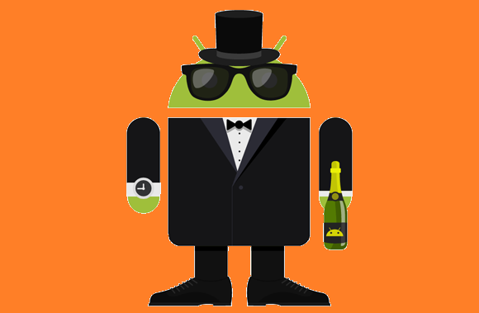
Thank You

